Slide 1
Computing: String Manipulation

Slide 2
Learning Objective
Learn different techniques to manipulating a string in python

Slide 3
String manipulation
What is it?
Don’t say Manipulating strings!

Slide 4
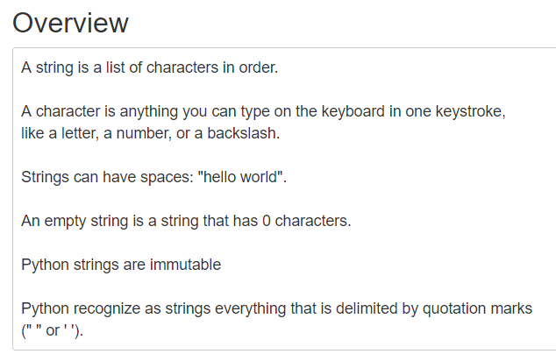

Slide 5
String manipulation
In Python, we can modify and change strings using some built in commands.
These commands can be used to change the appearance of strings, often by slicing them or selecting a number of characters from the words themselves.
String manipulation techniques are very useful when building validation procedures in your programs.

Slide 6
String Manipulation
To manipulate strings, we can use some of Pythons built-in methods
Creation
word = “Hello World”
>>>print (word)
Hello World
Accessing
Use [ ] (Square Brackets) to access characters in a string
word = “Hello World”
letter = word[0]
>>>print(letter)
H

Slide 7
Length
word = “Hello World”
>>>len(word)
11
Finding
>>>print(word.count(“l”))
3
>>>print(word.find(“H”))
0
>>>print(word.index(“World”))
6

Slide 8
Slicing
Use [# : #] to get set of letter
Keep in mind that python, as many other languages, starts to count from 0!!
word = “Hello World”
print(word[0]) get one character of the word
print(word[0:1]) get one character of the word (same as above)
print(word[0:3]) get the first three character
print(word[:3]) get the first three character
print(word[-3:]) get the last three character
print(word[3:]) get all but the first three characters
print(word[:-3]) get all but the last three characters

Slide 9

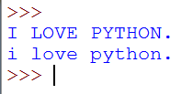
Example
.upper() and .lower()
These commands simply replace any given string with uppercase or lowercase.

Slide 10
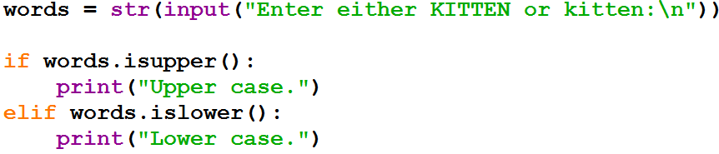
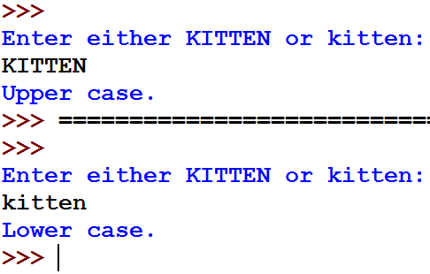
Manipulated if

Slide 11

Finding a character or a sequence:
We can use the .find() command to locate a particular character, or set of characters within any given string.
This will return a value which states the where the character/s start in the sequence.
What value will be returned once the above program is run?

Slide 12

Replacing characters
We can use the .replace() command to swap a character, or set of characters with something else.

Slide 13
What do these do?
----- .replace()
----- .find()
----- .count()
----- .lower()
----- .isupper()
----- word[2:6] PTAI word = “CAPTAIN AMERICA”
----- number[1:10:2] number = 1, 2, 3, 4, 5, 6, 7, 8, 9, 10
(2, 4, 6, 8, 10)

Slide 14
What do these do?
----- .replace()
----- .find()
----- .count()
----- .lower()
----- .isupper()
----- word[2:6] PTAI word = “CAPTAIN AMERICA”
----- number[1:10:2] number = 1, 2, 3, 4, 5, 6, 7, 8, 9, 10
(2, 4, 6, 8, 10)

Slide 15
Now Complete the Work Sheets
String manipulation.

Slide 16
Activity
Build a program with the following system requirements:
Entering a surname, age and class
Checking if the data entered is completely correct (data type & length)
Creating the username by finding the last 4 characters of the surname, and adding the student’s age.
Allowing the student to be able to create their own password.
Checking their passwords match.

